Slide 1
INSTRUCTION FORMATS

Slide 2
INSTRUCTION FORMAT
Instruction Format
Instruction Fields
OP-code field - specifies the operation to be performed
Address field - designates memory address(s) or a processor register(s)
Mode field - specifies the way the operand or the
effective address is determined
The number of address fields in the instruction format
depends on the internal organization of CPU
- The three most common CPU organizations:
  Single accumulator organization:
  ADD X /* AC ← AC + M[X] */
  General register organization:
  ADD R1, R2, R3 /* R1 ← R2 + R3 */
  ADD R1, R2 /* R1 ← R1 + R2 */
  MOV R1, R2 /* R1 ← R2 */
  ADD R1, X /* R1 ← R1 + M[X] */
  Stack organization:
  PUSH X /* TOS ← M[X] */
  ADD

Slide 3
A 3 address instruction specifies memory addresses for both operands and the result
  R ←Op1 op Op2
A 2 address instruction overwrites one operand in memory with the result
  Op2 ← Op1 op Op2
A 1 address instruction has a processor, called the accumulator register to hold one operand & the result (no addr. needed)
  Acc ← Acc op Op1
A 0 address instruction uses a CPU register stack to hold both operands and the result
  TOS ← TOS op SOS
  where TOS is Top Of Stack, SOS is Second On Stack)
The 4-address instruction, hardly ever seen, also allows the address of the next instruction to specified explicitly.

Slide 4
4-Address Instruction
The 4-address instruction:
Explicit addresses for operands, results and next instruction
Example assumes 24-bit address; Each address requires 3 bytes ,so it will require
4X3+1= 13 bytes to encode a 4-address ALU instruction.

Slide 5
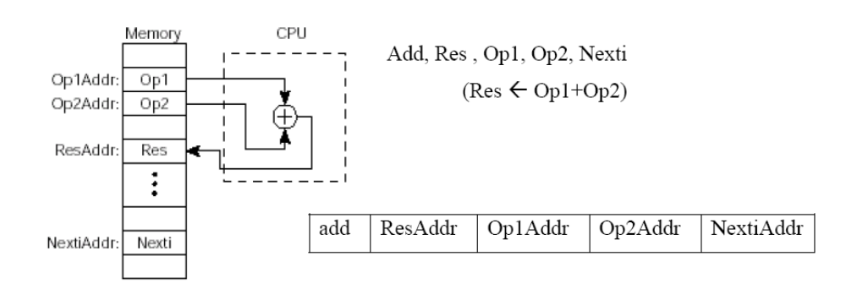
4- Address Machine and Instruction Format
Instruction Format
Bits
8
24
24
24
24
Which
operation
Where to
put result
Where to find operands
Where to find
next instruction

Slide 6
3-Address Instruction
3-Address instruction:
  Address of next instruction kept in processor state register—the PC (Except for explicit Branches/Jumps)
  Rest of addresses in instruction
  This Instruction will require 3X3+1= 10 bytes to encode a 3-address ALU instruction.

Slide 7
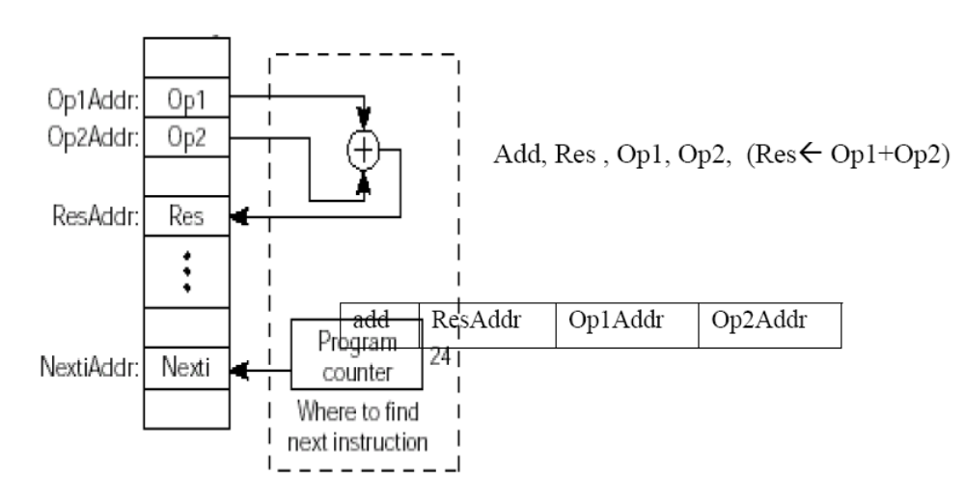
The 3-Address Machine and Instruction Format

Slide 8
The 2-Address, Machine and Instruction Format
2-address Instruction :
  Result overwrites Operand 2
  Needs only 2 addresses in instruction but less choice in placing data
  This Instruction will require 2X3+1= 7 bytes to encode a 2-address ALU instruction.

Slide 9
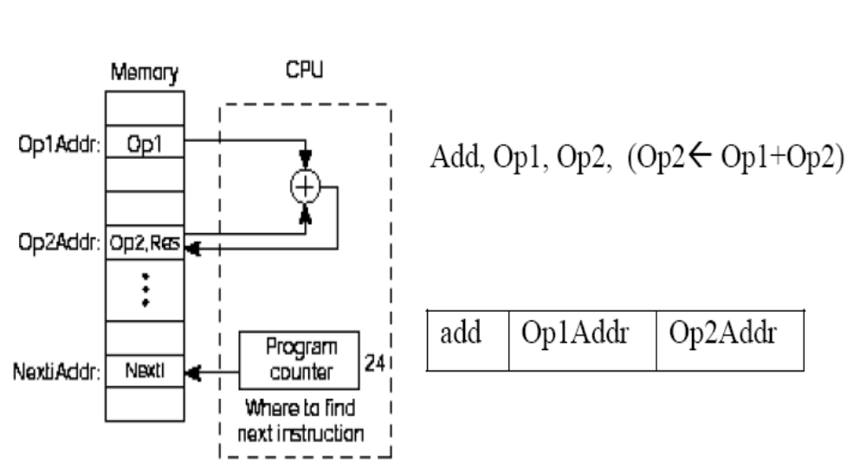
The 2-Address, Machine and Instruction Format

Slide 10
1-Address Instruction
1-address Instruction :
  Special CPU register, the accumulator, supplies 1 operand and stores result
  One memory address used for other operand
  Need instructions to load and store operands:
    LDA OpAddr
    STA OpAddr
This Instruction will require 1X3+1= 4 bytes to encode a 1-address ALU instruction

Slide 11
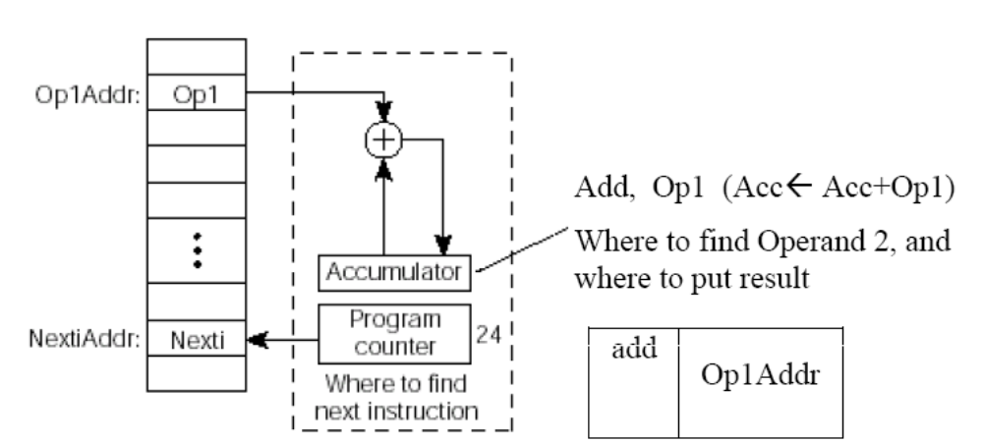
The 1-Address Machine and Instruction Format

Slide 12
0-Address Instruction
Uses a push down stack in CPU
Arithmetic uses stack for both operands and the result
Computer must have a 1-address instruction to push and pop operands to and from the stack

Slide 13
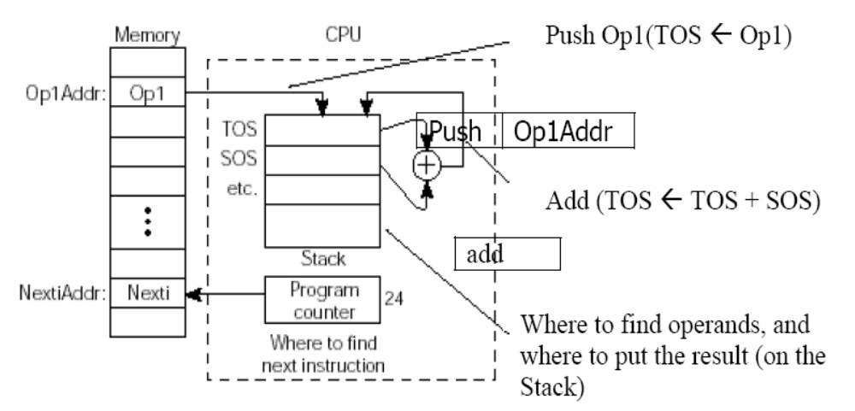
The 0-Address, or Stack, Machine and Instruction Formats

Slide 14
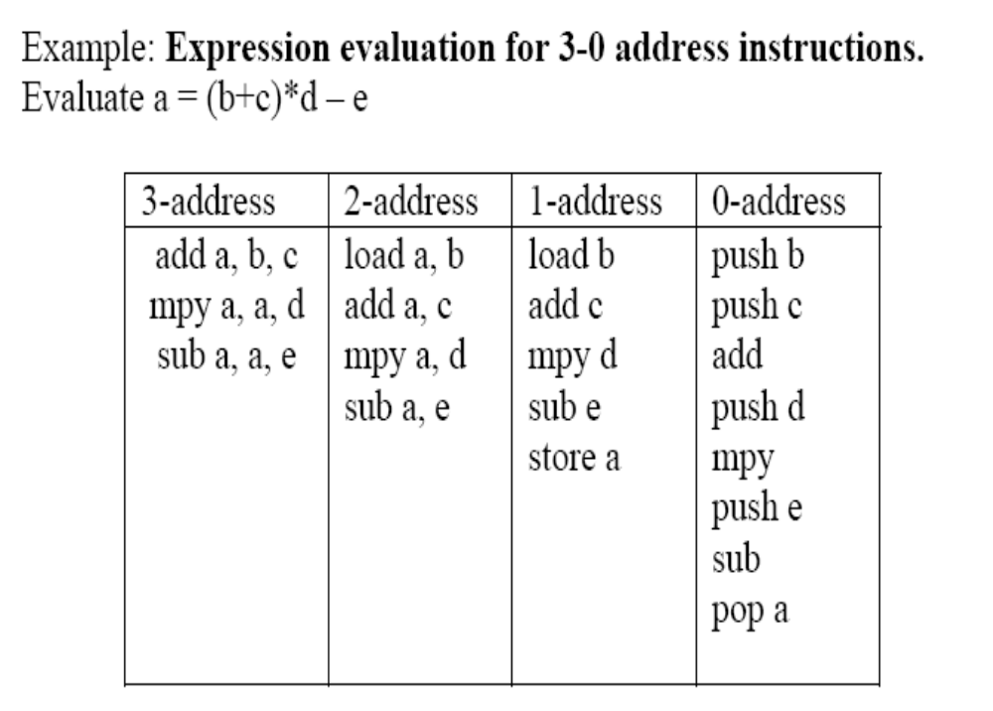

Slide 15
Evaluate a = (b+c)*d - e
3-Address
add a, b, c
a←b+c
0-Address
mpy a, a, d
a←a*d
push b
sub a, a, e
a←a-e
push c
2-Address
add
mov a, b
a←b
push d
add a, c
a←a+c
mpy
mpy a, d
a←a*d
push e
sub a, e
a←a-e
1-Address
sub
load b
Acc←b
pop a
add c
Acc←Acc+c
mpy d
Acc←Acc*d
sub e
Acc←Acc-e
store a
a←Acc

Slide 16
INSTRUCTION TYPES

Slide 17
Instruction Types
Data Transfer Instructions
Data Manipulation Instructions
Program control/ Conditional branch instructions
Program Interrupt instructions

Slide 18
DATA TRANSFER INSTRUCTIONS
Typical Data Transfer Instructions
Name Mnemonic
Load LD
Store ST
Move MOV
Exchange XCH
Input IN
Output OUT
Push PUSH
Pop POP
Data Transfer Instructions with Different Addressing Modes
Mode
Assembly
Convention
Register Transfer
Direct address LD ADR AC ← M[ADR]
Indirect address LD @ADR AC ← M[M[ADR]]
Relative address LD $ADR AC ← M[PC + ADR]
Immediate operand LD #NBR AC ← NBR
Index addressing LD ADR(X) AC ← M[ADR + XR]
Register LD R1 AC ← R1
Register indirect LD (R1) AC ← M[R1]
Autoincrement LD (R1)+ AC ← M[R1], R1 ← R1 + 1
Autodecrement LD -(R1) R1 ← R1 - 1, AC ← M[R1]

Slide 19
DATA MANIPULATION INSTRUCTIONS
Three Basic Types:
Arithmetic instructions
Logical and bit manipulation instructions
Shift instructions
Arithmetic Instructions
Name Mnemonic
Increment INC
Decrement DEC
Add ADD
Subtract SUB
Multiply MUL
Divide DIV
Add with Carry ADDC
Subtract with Borrow SUBB
Negate(2’s Complement) NEG
Logical and Bit Manipulation Instructions
Shift Instructions
Name Mnemonic
Name Mnemonic
Clear CLR
Complement COM
AND AND
OR OR
Exclusive-OR XOR
Clear carry CLRC
Set carry SETC
Complement carry COMC
Enable interrupt EI
Disable interrupt DI
Logical shift right SHR
Logical shift left SHL
Arithmetic shift right SHRA
Arithmetic shift left SHLA
Rotate right ROR
Rotate left ROL
Rotate right thru carry RORC
Rotate left thru carry ROLC

Slide 20
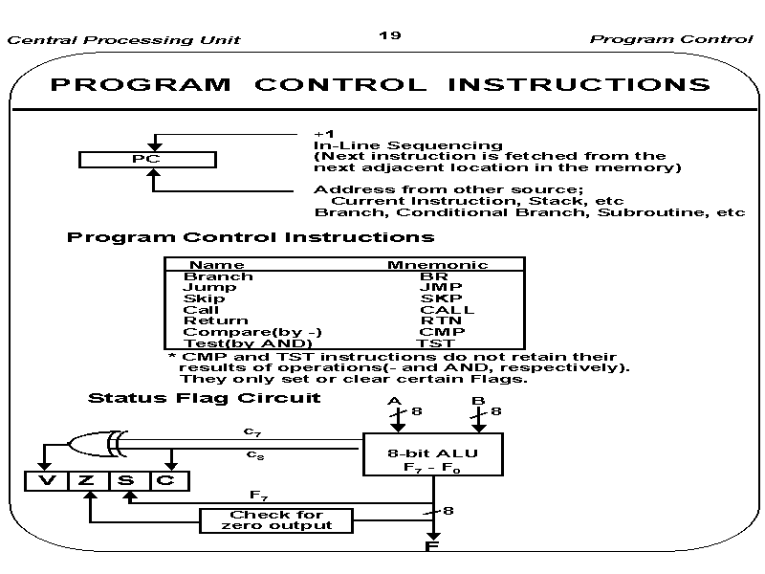

Slide 21
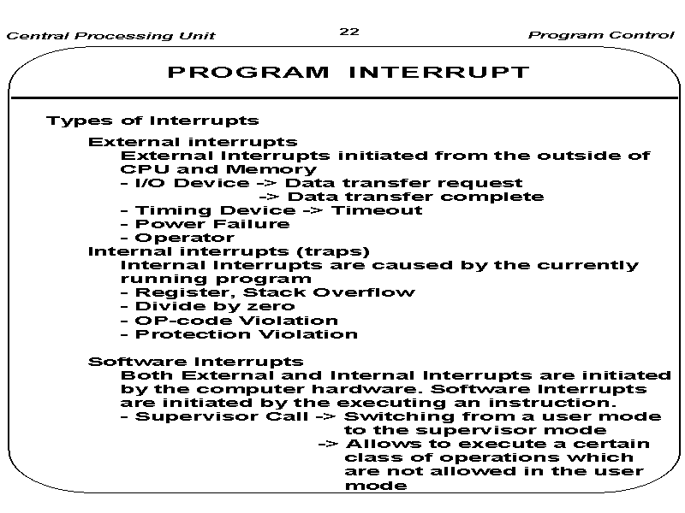
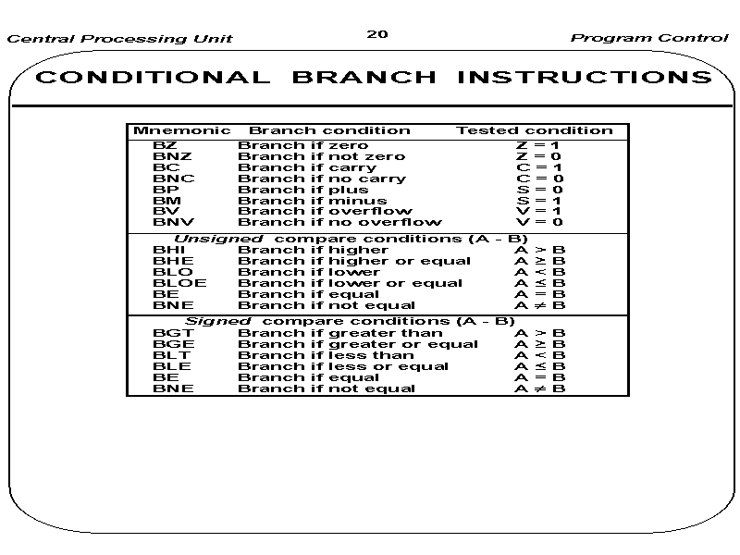

Slide 22
Subroutine Call and Return Mechanisms
Subroutine is a self-contained sequence of instructions that performs a given computational task.
It may be called many times at various points in the main program
When called, branches to 1st line of subroutine and at the end, returned to main program.
Different names to the instruction that transfers program control to a subroutine
  Call subroutine
  Jump to subroutine
  Branch to subroutine
  Branch and save address

Slide 23
Subroutine call
CALL
SP ← SP – 1 decrement SP
M[SP] ← PC Push content of PC into stack
PC ← Effective Address (EA) Transfer control to subroutine.
RTN
PC ← M[SP] POP stack and transfer to PC.
SP ← SP + 1 Inc SP
Recursive subroutine is a subroutine that calls itself.

Slide 24
Recursive subroutines
Subroutine that calls itself
If only one register or memory location is used to hold the return address, when subroutine is called recursively, it destroys the previous return address.
So, stack is the good solution for this problem

